Slide 1

SAFAR- A Travel Website
Web Designing Project
Name : Mehakpreet
Roll No: 12101038
Group: 3CE-2

Slide 2
What is Web Designing ?
Web Designing is Planning and Creation of Websites. It deals with the process of developing a website. Web Designing ranges from creating plaintext pages to complex web-based applications, social network applications and electronic business applications.
It involves creating the visual and functional elements of websites or web applications. It encompasses various aspects, including layout, color scheme, typography, graphics, images, and interactive features, all aimed at enhancing user experience and achieving the website's objectives.

Slide 3


INTRODUCTION
Project Details:
Title : Safar Travel
Type : Travel Booking Website
Technology Used:
1. HTML (HyperText Markup Language)
2. CSS (Cascasding Styles Sheet)
3. JavaScript

Slide 4
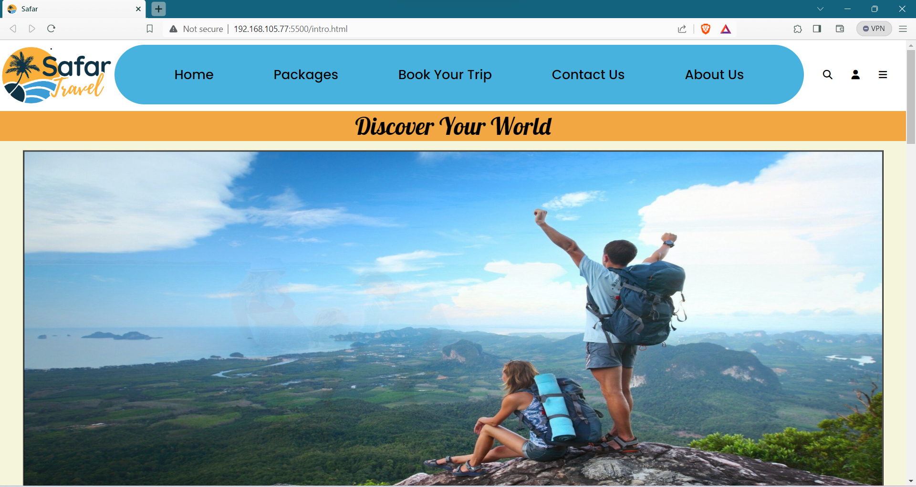
Homepage of the Website
Navigation Bar
Login Profile
Image Slider

Slide 5
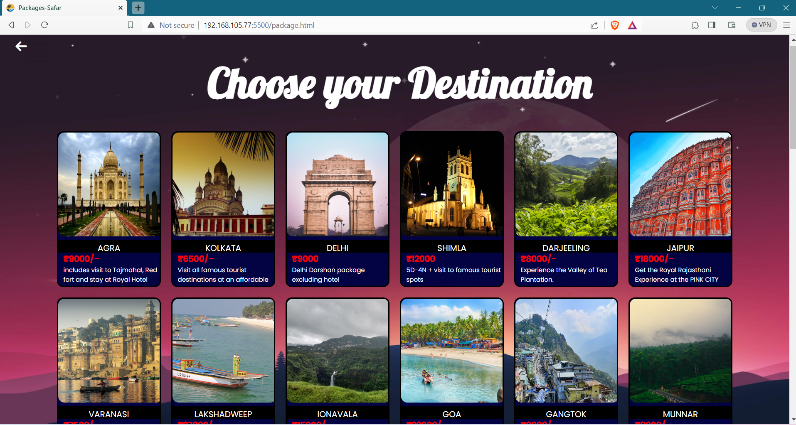
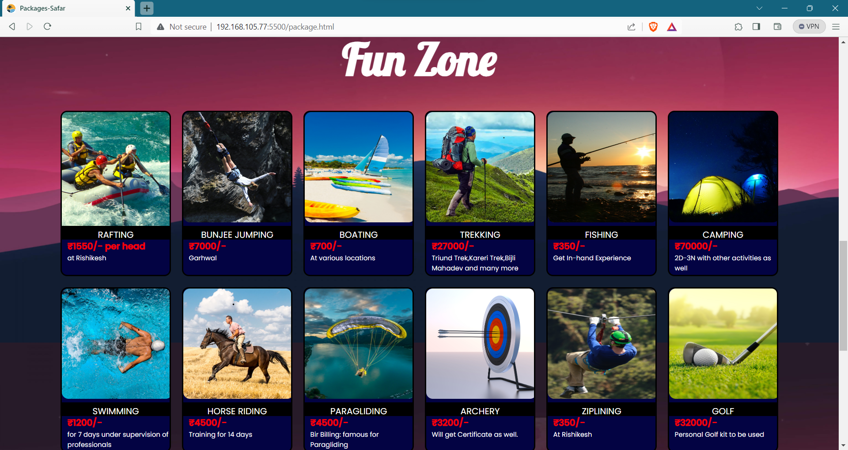
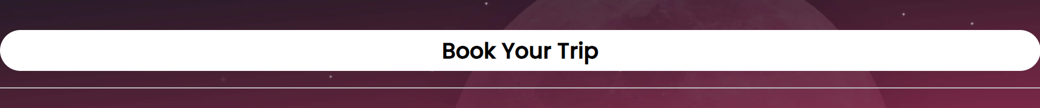
Packages Page
This Page contains Different Packages for Destinations and Activities after selecting the preferred ones. The User selects and Taps the BOOK YOUR TRIP button
Tap to Book

Slide 6
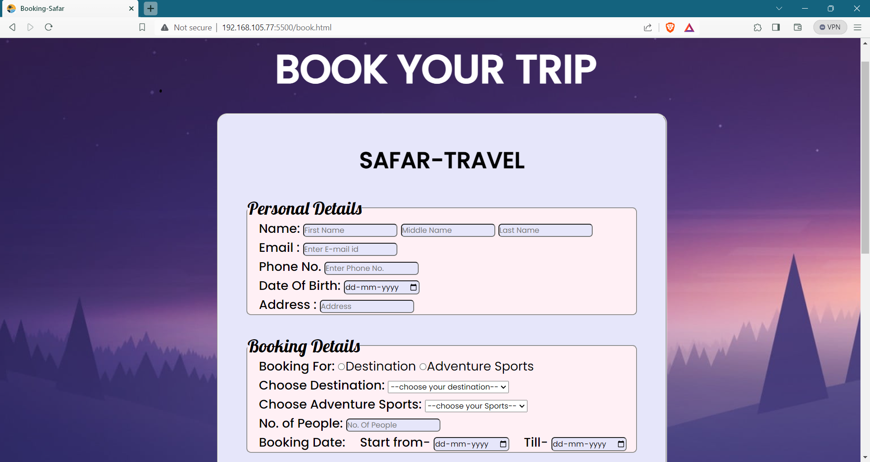
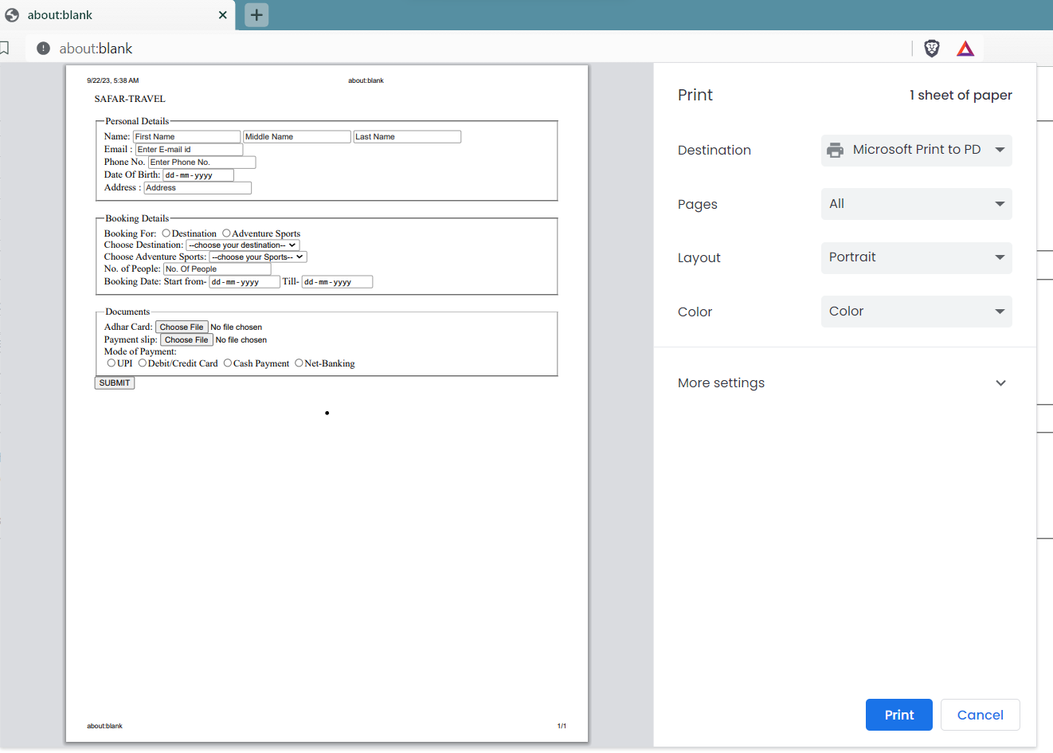
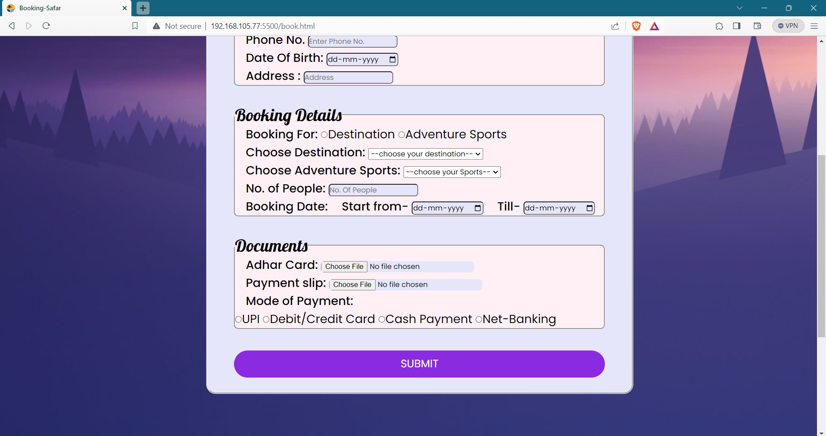
BOOKING PAGE
Receipt For Booking
Fill The Form to BOOK
Tap to Submit and Print Receipt

Slide 7
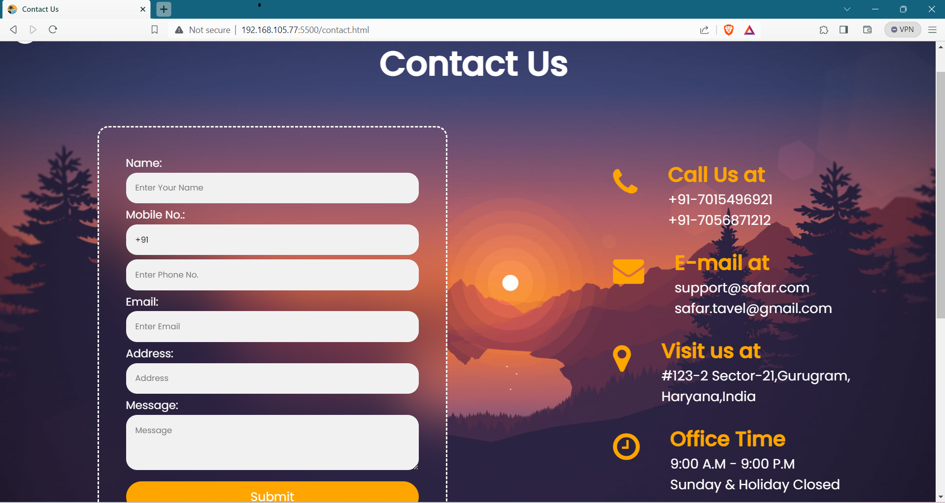
CONTACT US PAGE
This Page Gives Information regarding Contact details for user to ask their query and resolve issue with the authority of the SAFAR travel website like Phone no.,e-mail address, Office Address etc.

Slide 8
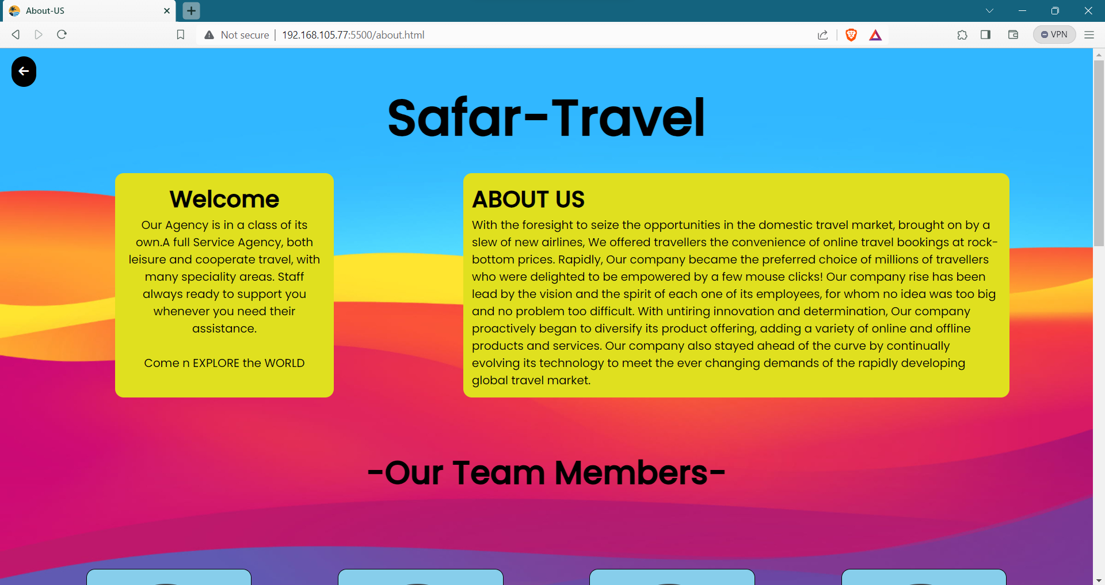
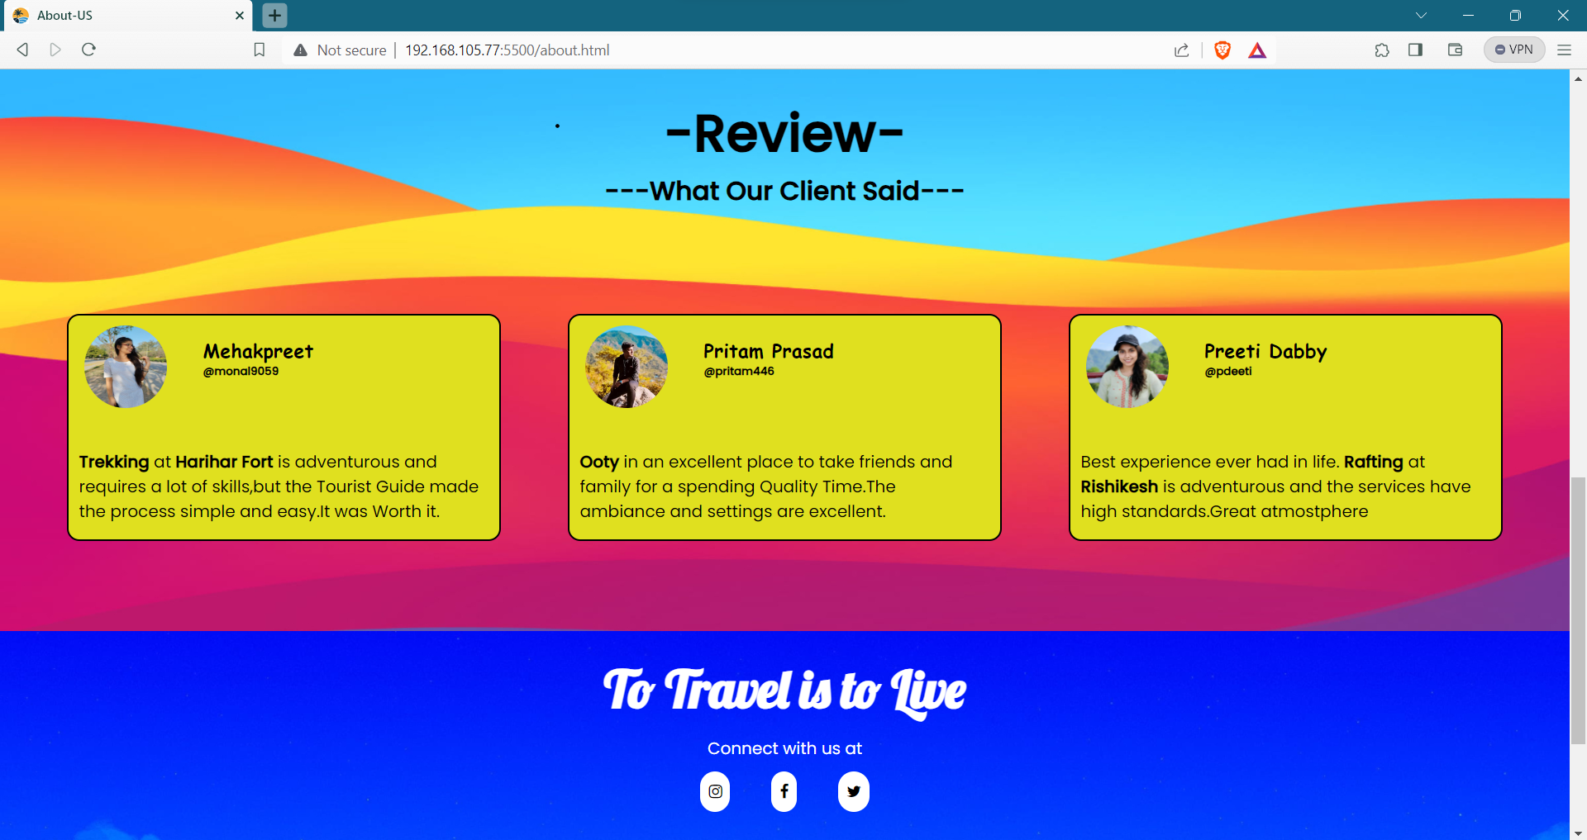
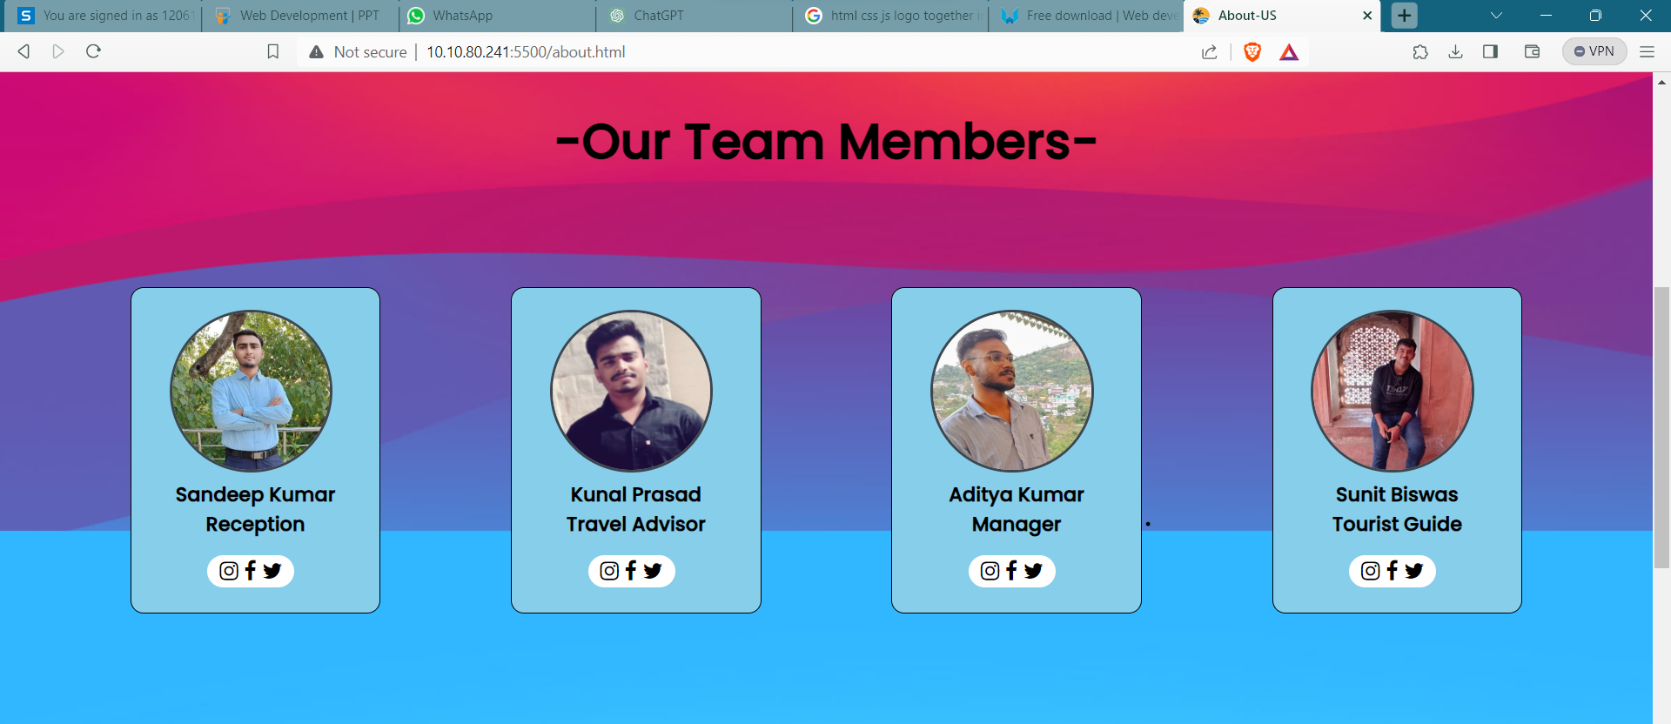
About Us
Description about Company
Reviews form Customers
Organisation Team Members

Slide 9
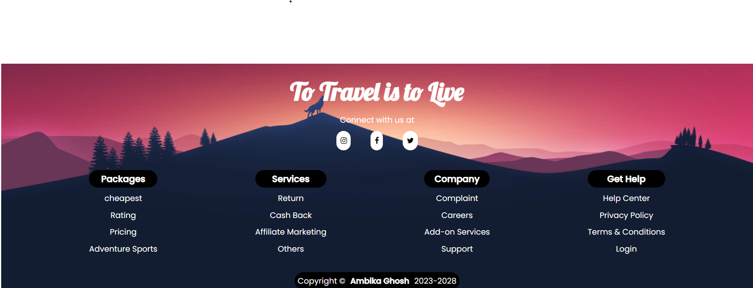
FOOTER
It commonly includes contact details, such as address, phone number, and email, facilitating user communication
Links for social media

Slide 10


Conclusion
Safar, a user-centric travel platform, seamlessly facilitates personalized travel experiences. Its intuitive interface, encompassing curated travel information and smart search features, empowers users to craft tailored itineraries. With a commitment to reliability and safety, Safar ignites wanderlust, making the world easily accessible and encouraging unforgettable adventures. It's a go-to portal for those seeking memorable journeys and a deeper connection with diverse cultures, embodying the joy of exploration and the essence of travel.

Slide 11
Future Scope
The future scope for Safar website lies in continued innovation and expansion, positioning it as a leading travel-tech platform:
Global Expansion: Scaling operations to include more international destinations, catering to a broader audience and diverse travel interests.
Enhanced Personalization: Utilizing advanced AI algorithms to tailor recommendations based on user preferences, optimizing travel plans and experiences.
Integration of AR/VR: Implementing augmented and virtual reality for immersive destination previews, enriching trip planning and engagement.
Community Engagement: Facilitating a vibrant travel community for shared experiences, tips, and reviews, fostering user interaction and trust.
Sustainability Focus: Incorporating eco-friendly travel options, promoting responsible tourism and environmental awareness.
Mobile Optimization: Prioritizing mobile user experience to accommodate the increasing trend of on-the-go travel planning and bookings.

Slide 12
REFRENCES
Websites:
w3school - https://www.w3schools.com/
TripAdvisor – https://www.tripadvisor.com/
JavaScript.info - https://javascript.info/
Importance: JavaScript.info is a comprehensive guide to JavaScript. It covers the language basics, DOM manipulation, and advanced concepts.
Online Sources:
Websites like Udemy, Coursera, and freeCodeCamp offer courses on web development, including HTML, CSS, and JavaScript.
Importance: These platforms provide structured learning and can support your understanding of the technologies used in the project.
Magazine and News Articles:
Articles from reputable travel and technology magazines or news outlets.

Slide 13

THANK
YOU

